Slide 1
Regression

Slide 2
About Regression
What is regression?
When is it used?
Let’s use an example of house rent again

Slide 3
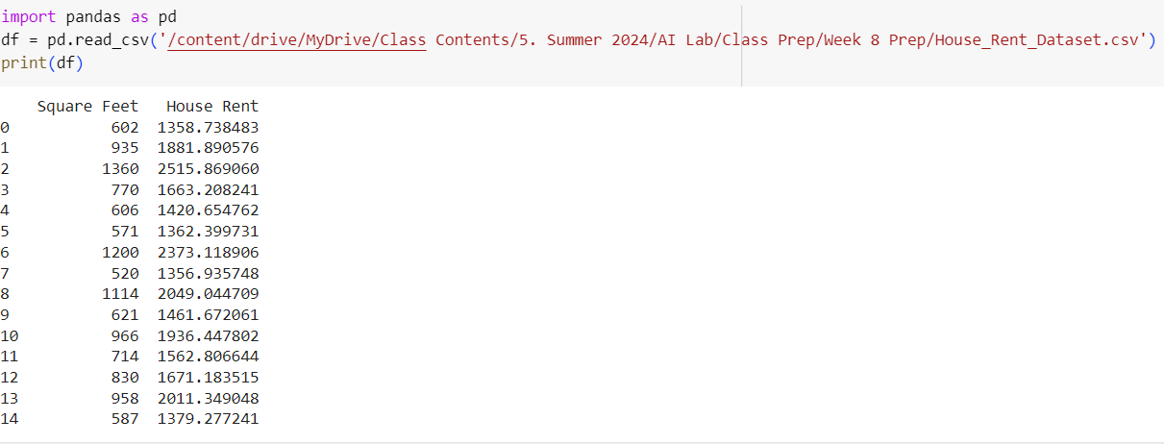
Let’s see the data
Mount the google drive
Upload the dataset in your designated folder in your drive
Access it using pandas
Visualize it

Slide 4
Let’s see the data
Is there a better way to visualize this?
Mount the google drive
Upload the dataset in your designated folder in your drive
Access it using pandas
Visualize it

Slide 5
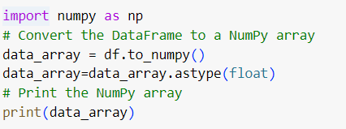
But first, let us transform it into a NumPy array
We had done this before!

Slide 6
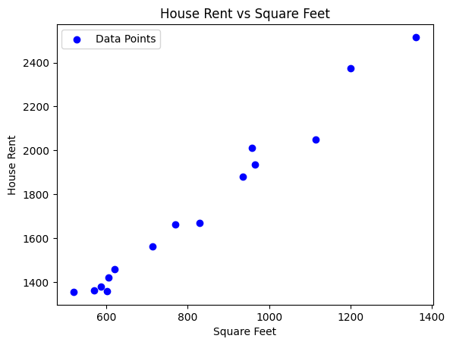
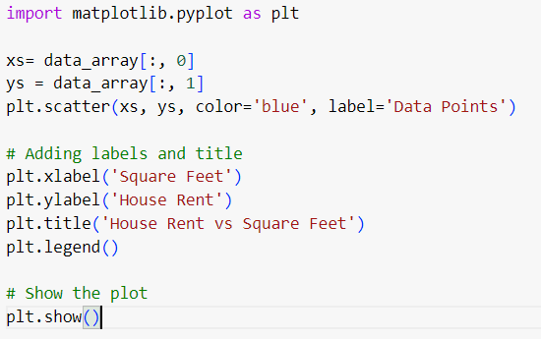
Introducing matplotlib
Does this plotting remind you of something?
Y=mx+c
Notes:
500 and 1.5

Slide 7
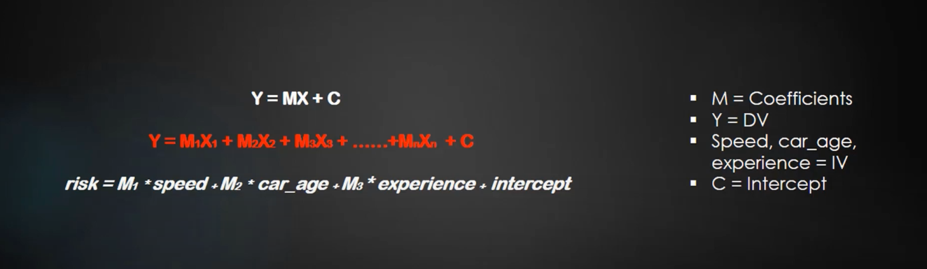
Multiple linear Regression

Slide 8

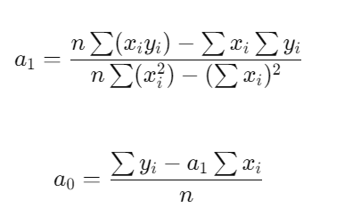
Linear Regression – finding the best st. line

Slide 9
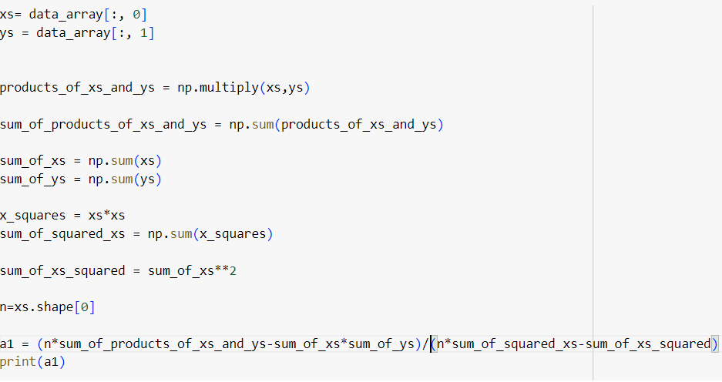
Python code for a1

Slide 10

Python code for a0

Slide 11
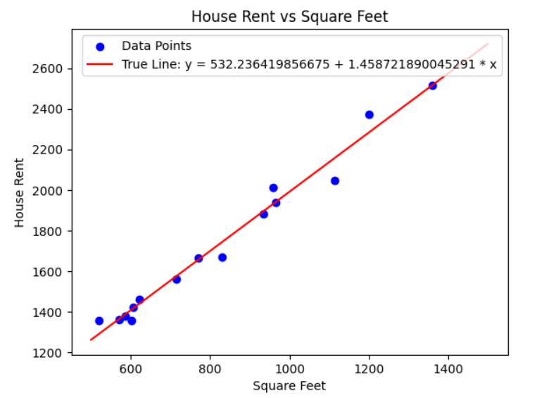
Now plot this line
y=a0 + a1x

Slide 12
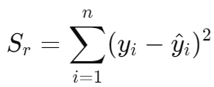
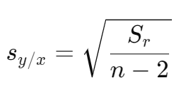
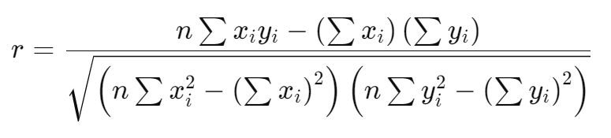

Metrics for evaluating the obtained equation

Slide 13
Metrics for evaluating the obtained equation
1. Sr​ (Residual Sum of Squares):
This is the total amount of error in your regression model.
It tells you how far off your predicted values are from the actual values.
A smaller Sr​ means your model predicts the data more accurately.
Example: If Sr=500, this means the total error in the predictions (squared differences between actual and predicted values) adds up to 500.

Slide 14
Metrics for evaluating the obtained equation
2. Sy/x (Standard Error of the Estimate):
This tells you, on average, how much your predictions deviate from the actual values.
It’s like the average "error" per prediction.
Example: If Sy/x=5, this means, on average, your model's predictions are 5 units off from the actual values.

Slide 15
Metrics for evaluating the obtained equation
3. r (Pearson Correlation Coefficient):
This measures the strength and direction of the relationship between your independent variable and dependent variable.
It ranges from -1 to 1:
r=1: Perfect positive linear relationship.
r=−1: Perfect negative linear relationship.
r=0: No linear relationship.
Example: If r=0.85, this means a strong positive relationship between x and y, meaning as x increases, y also increases.

Slide 16
Metrics for evaluating the obtained equation
4. r² (Coefficient of Determination):
This is the square of the correlation coefficient, and it tells you how much of the variation in y is explained by the model.
r₂ ranges from 0 to 1:
r²=1: Your model perfectly explains the data.
r²=0: Your model does not explain any of the variation in the data.
Example: If r²=0.72, this means 72% of the variation in y (e.g., house rent) is explained by the independent variable x (e.g., square footage).

Slide 17
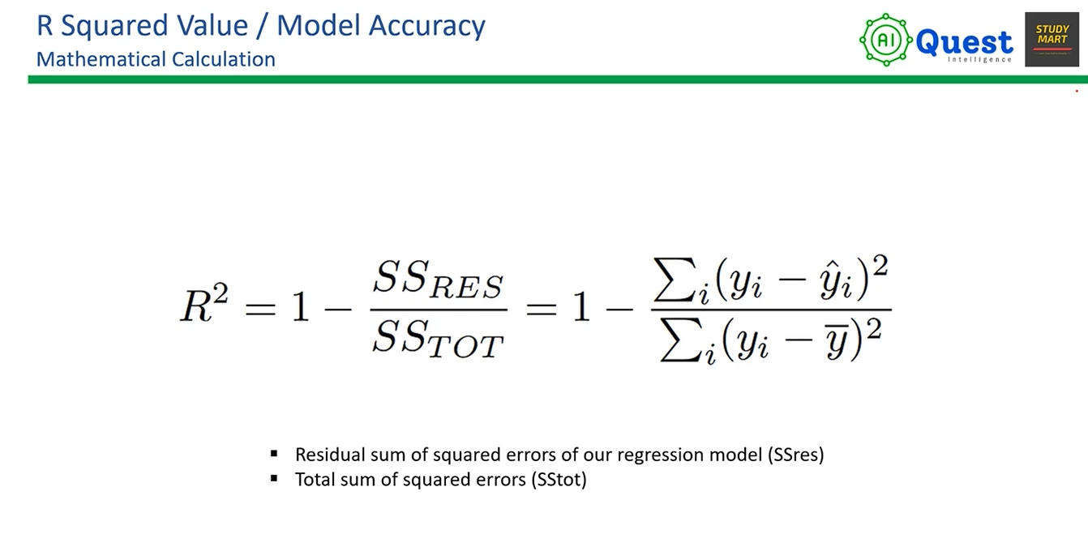

Slide 18
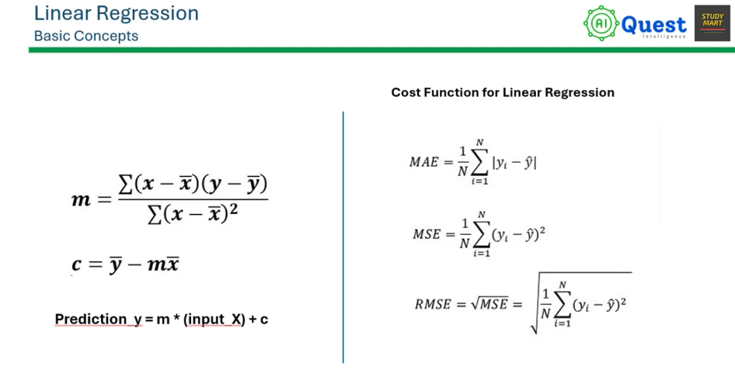

Slide 19
Assignment 3 – Task 1
Calculate the S_{r} , S_{x/y} , r and r² for the problem solved in class.

Slide 20

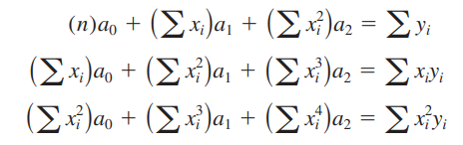

Polynomial Regression

Slide 21

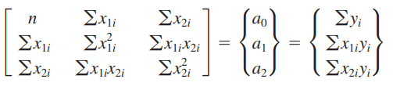

Multiple Linear Regression

Slide 22
Assignment 3 – Task 2
A dataset for carrying out multiple linear regression will be given. You need to build a model using the formula given in the previous slide.
Note: There will be a quiz based on today’s lecture, codes and your assignment.

